Slide 1
Proposal for HOOF Information System
Specter Designs

Slide 2
Agenda
Problem Areas
Problem Areas Improvement
Benefits of Our Improvements
System Requirements
Windows Navigation Diagram
Prototypes
Conclusion

Slide 3
Potential Problem Areas
Lack of an online presence, limiting company awareness
Lack of online donation options for users, limiting the ways they can give.
Lack of central information source, increasing information gathering time

Slide 4
Problem Areas Improvement
We want to create a centralized database where all the company data may be stored and accessed
We Believe we can improve donation revenue through expanding online options.
We see ways to facilitate improvement in the grant writing process

Slide 5
Benefits of Our Improvements
By conservative estimates, we expect to grow HOOF individual Donations by 20%, about $550 through increased engagement and online donation options
We expect to increase Grants by a conservative estimate of 20%, about $3,600 by halving the time to write grants.
Proper Social Medial outreach might bring in another 10% conservative growth in individual donations, about $225

Slide 6
System Requirements Overview
Information Management: The system will be able to store information about Volunteers, Donors, and Campers to a Database
Managing Donors: the system will be able to accept donations in a variety of forms, with or without an account, and provide a receipt
Board Member Information: System will allow board members to upload files related to grants and access all information needed for grants.

Slide 7
Windows Navigation Diagram
The next slide is going to be our Windows Navigation Diagram
It is just a representation of where you can find all of you screens, forms and reports
It is also a useful tool to see how users will navigate through the system

Slide 8
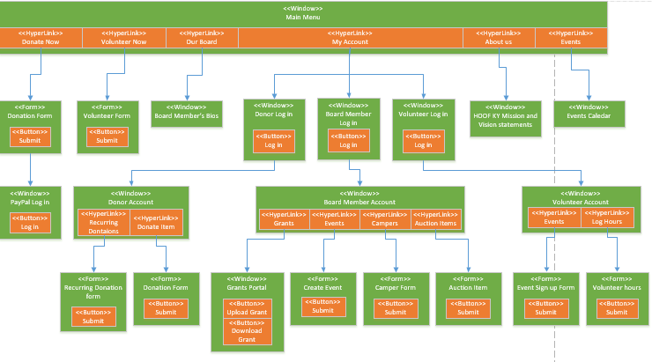

Slide 9
Prototypes of Our Design
We have designed models for key HOOF Web functions
These represent areas of high risk and importance to operations and donation income
These prototypes are presented in order of a user navigating the system.

Slide 10

Landing Page

Slide 11
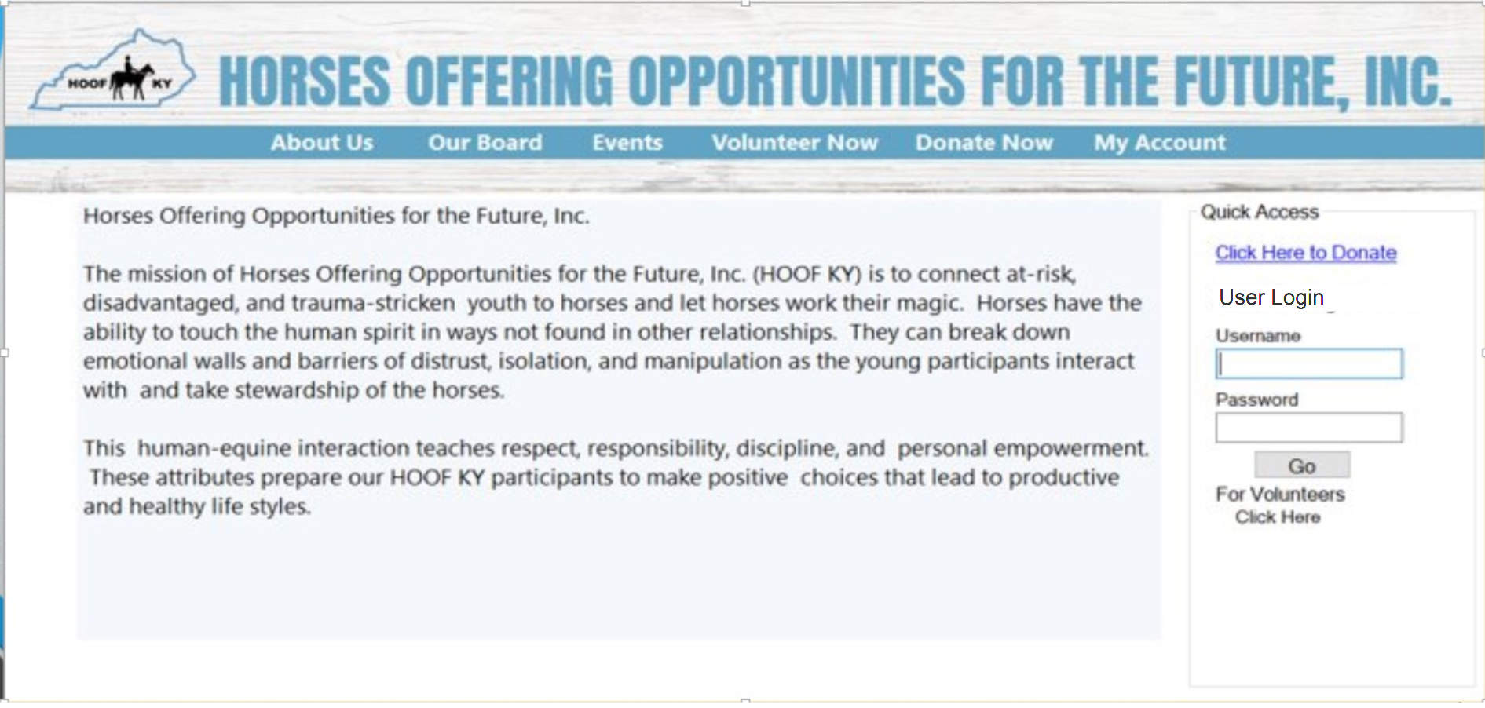
Donor Login

Slide 12
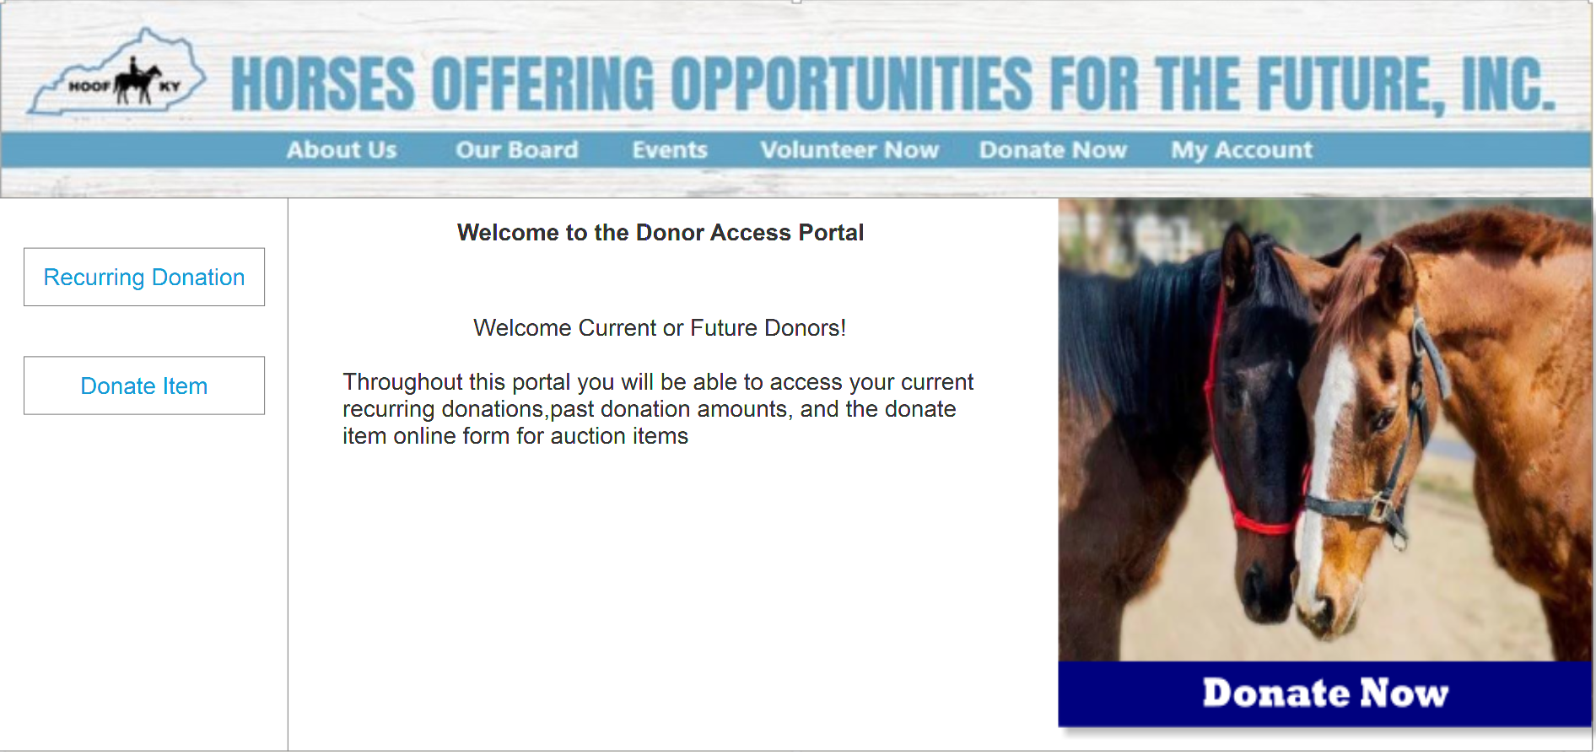
Donor Portal

Slide 13
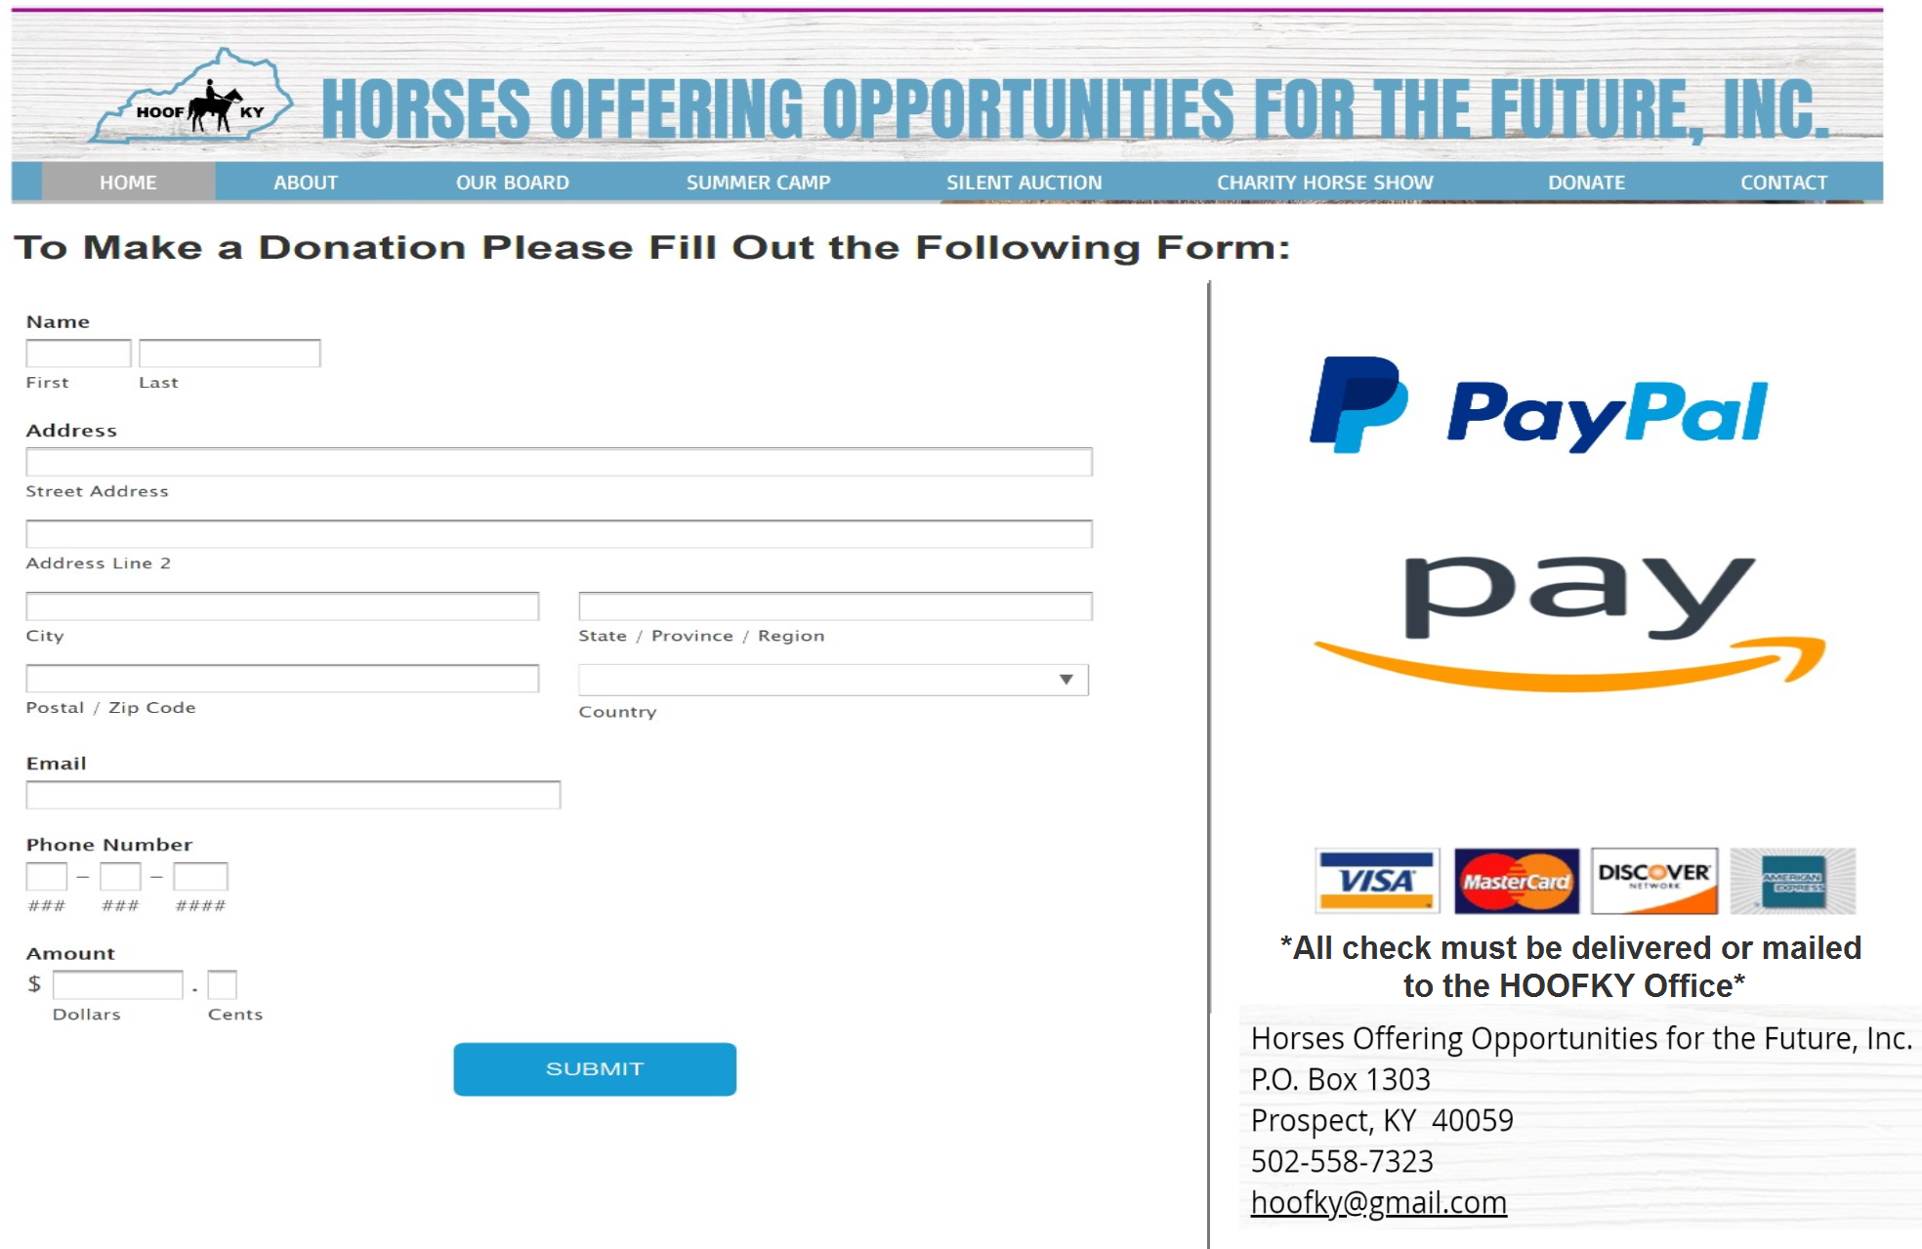
Donor Payment Options

Slide 14
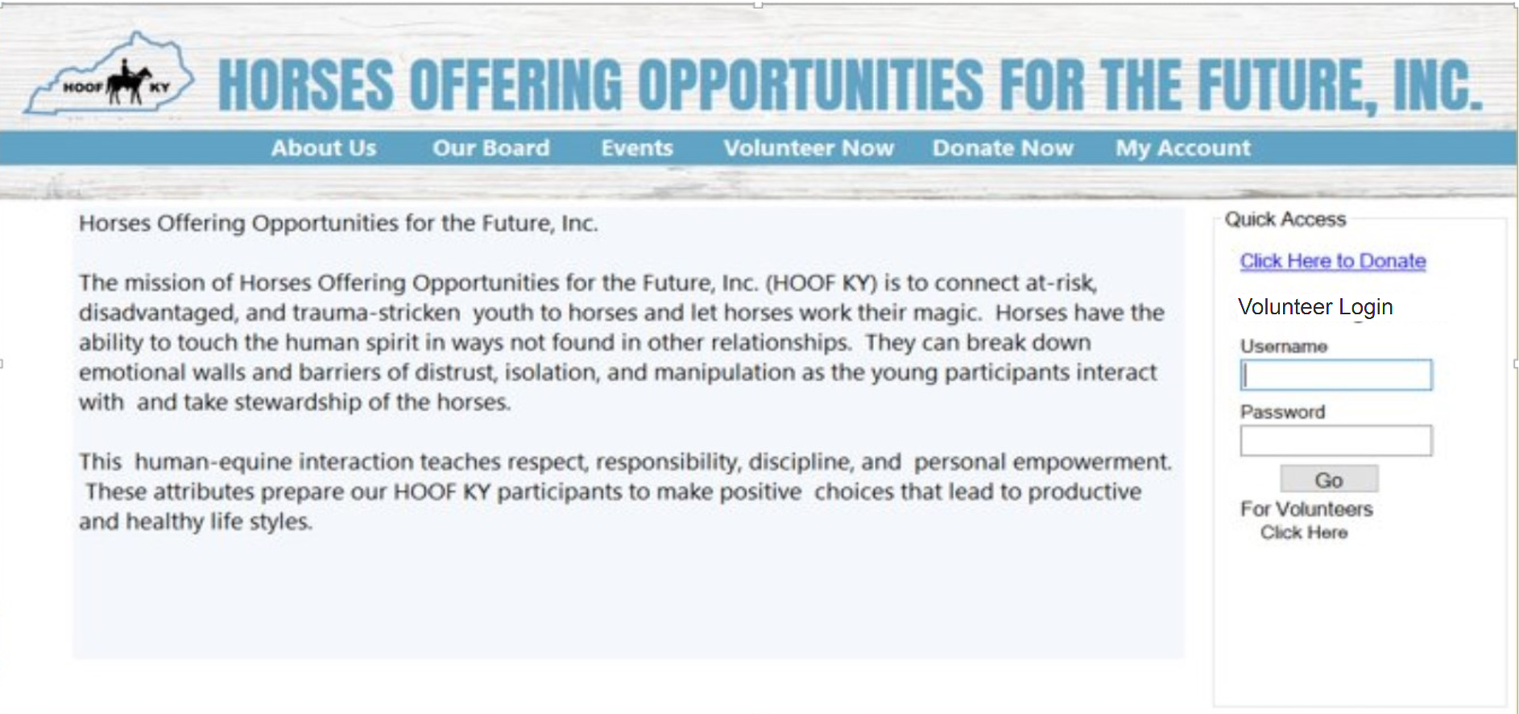
Volunteer Login

Slide 15
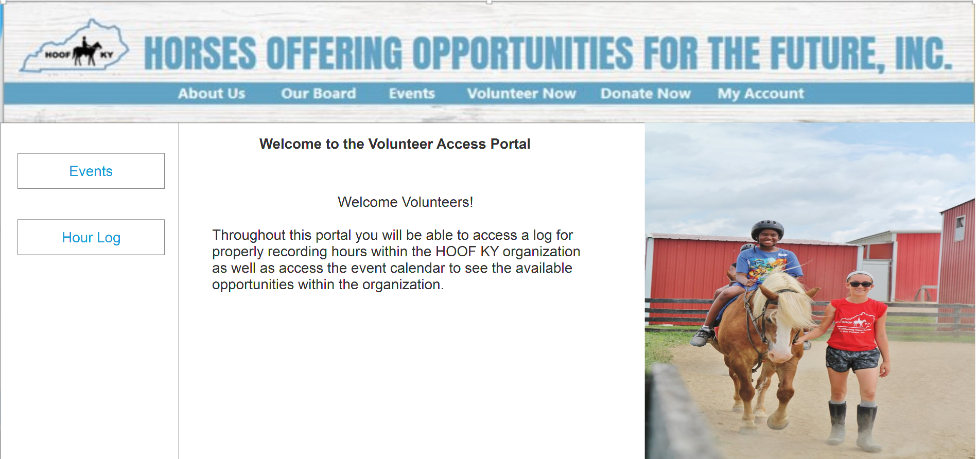
Volunteer Portal

Slide 16
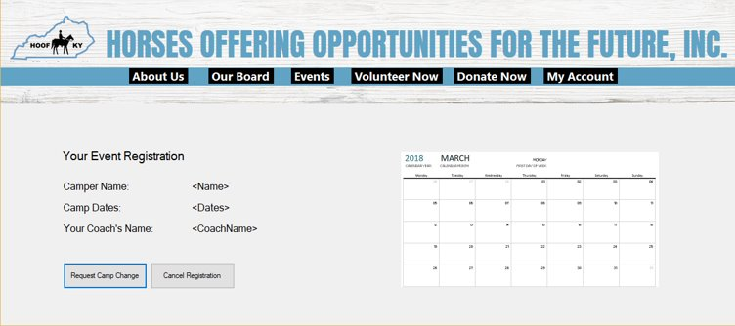
Register For Event

Slide 17
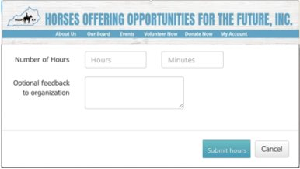
Log Volunteer Hours

Slide 18
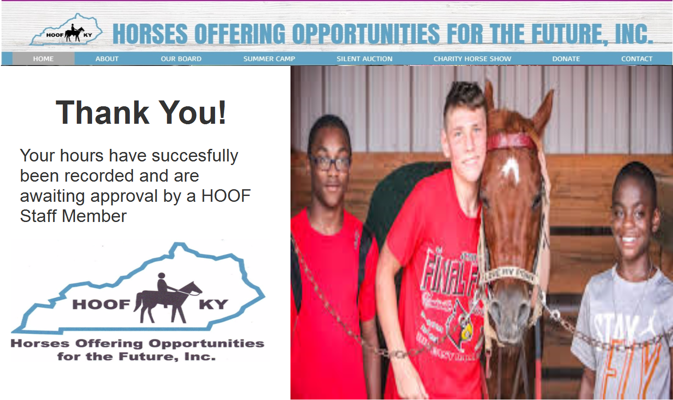
Confirmation

Slide 19
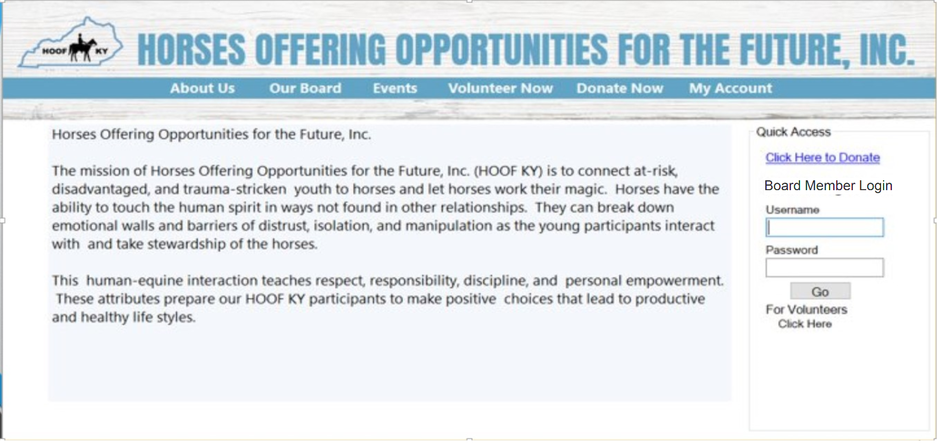
Board Member Login

Slide 20
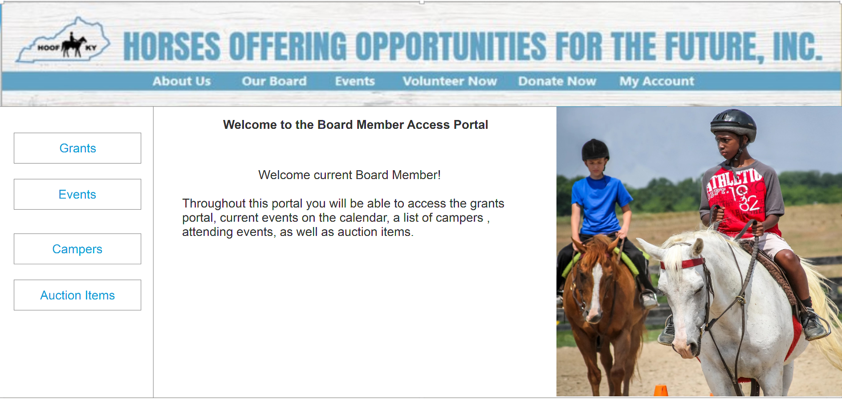
Board Member Portal

Slide 21
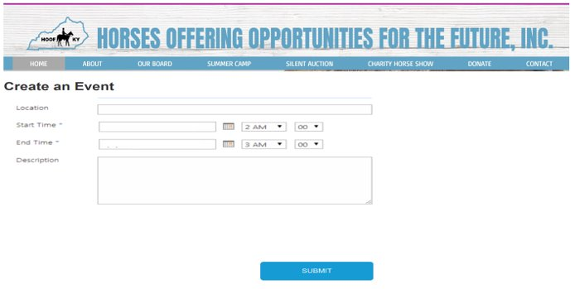
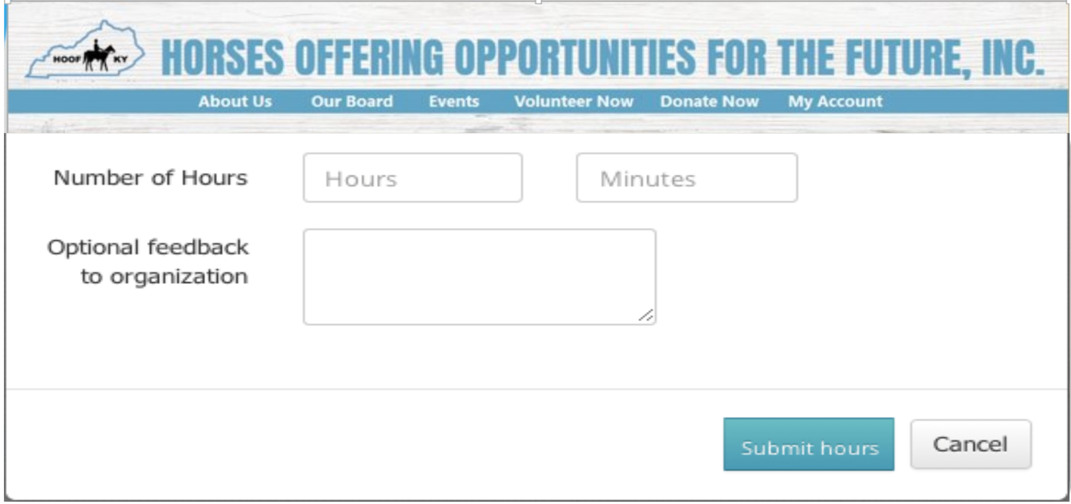
Creating an Event

Slide 22
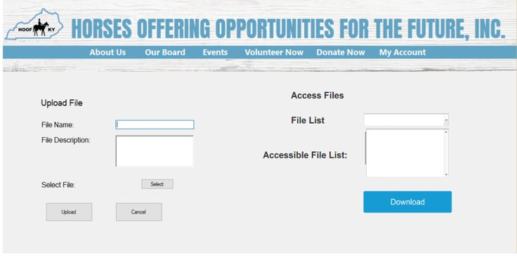
Board Member File Portal

Slide 23
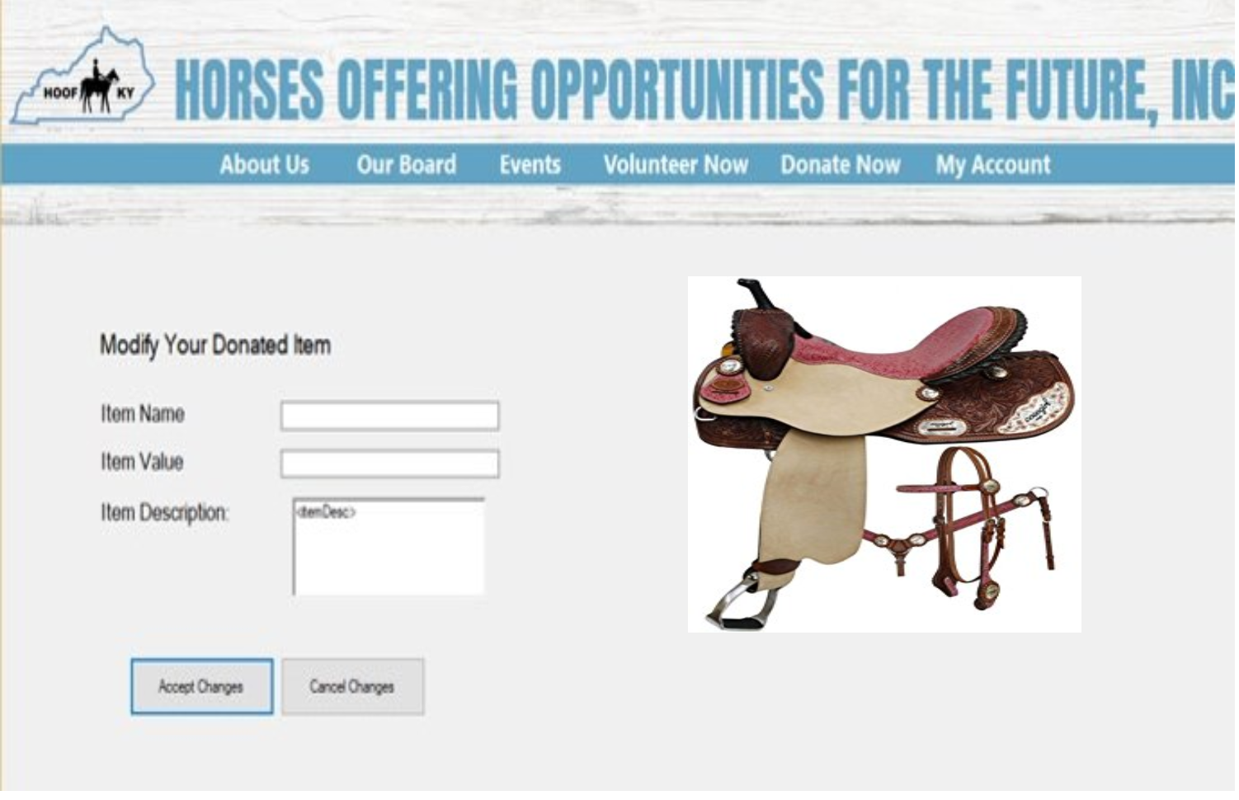
Modify Received Auction Items

Slide 24

Data Backup Service Provider
Easiest and most simple to use online backup service
$4.95/month = 75GB online backup storage
$6.95/month = Unlimited backup storage
Supports all Operating Systems
Including mobile devices
Provides:
Data encryption
File versioning
File recovery

Slide 25
Conclusion
The system we propose will increase HOOF's donation revenue and grants totaling to $4,375 per year additional revenues.
We have modeled prototypes that show our vision for pages in HOOF's information system
Any Questions?

